Slide 1
Understanding Budgets, Budget Justifications, & Post-Award Implications
Lori Uttech-Hanson, Clinical Research Center Administrator, SMPH, Department of Urology
Courtney Griese, Research Administrator, Cell and Regenerative Biology

Slide 2

Poll:
How many have been in research administration 2 years or less?

Slide 3
Part I: Budgets
Courtney Griese

Slide 4

What is a budget?
The budget is a financial representation of the scope of work. The budget should be an accurate representation of what is needed to carry out the research.
Purpose and Importance of a Budget
Helps reviewers determine how the project will be conducted
Budget details usually reveal whether a proposed project has been carefully planned and may ultimately be feasible.
Serves as a blueprint for spending the project’s funds
Integral part of the obligation to the sponsor, particularly regarding time/effort commitments
Notes:
A budget is a financial representation of the scope of work of a project. It helps reviewers see how the project will be conducted and if it is feasible with the funding available. Clear and realistic budgets show thoughtful proposal preparation and aid in the post-award management of the project. It’s very important that your narrative and budget contain the same story. If you mention animal work in the narrative but not in the budget, reviewers will be left wondering.

Slide 5
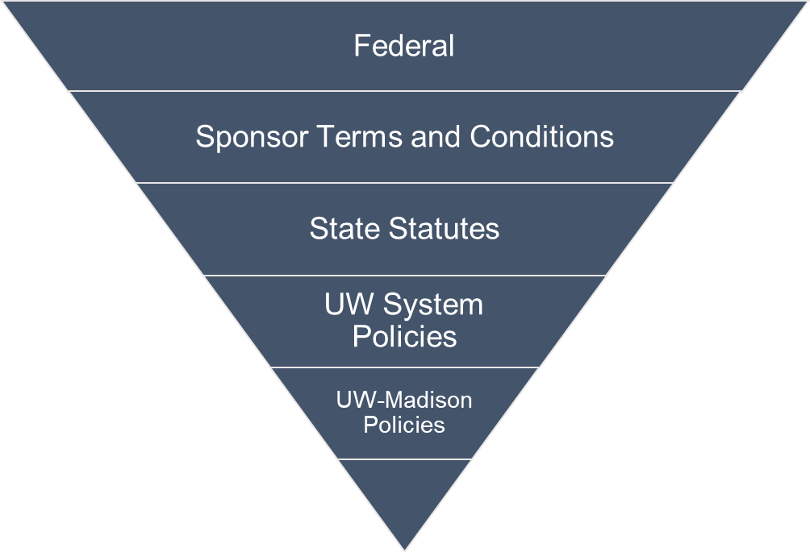

What can we put on a budget?
All budgeted expenses must meet Uniform Guidance Principles, as well as Sponsor Terms and Conditions, State, and Institutional policies
All budgeted lines must follow the cost principles and order of precedence.
Agency Terms and Conditions
Agency Program Announcements
Award
Terms
Notes:
All sponsored projects at UW-Madison are also subject first and foremost to purchasing regulations set forth by the University of Wisconsin-System, implemented through Purchasing Services. We want to make sure all budgets must be reasonable, allocable and allowable. Reasonable-the costs are appropriate to your geographic location and aren’t underestimated or overestimated. Allocable- including costs that are described in your narrative. Allowable-we need to ensure the budget conforms to the sponsor, conditions, state, and institutional polices. If you’re applying for federal funding, it’s important to adhere to the uniform guidance principles when thinking about what to include in our budgets. It’s a long document-a good bedtime read if you have trouble sleep. RSP has a helpful list on their website and I’ll go over some common allowable and unallowable expenses per CFR on the next slide. We always want to follow the guidance from the strictest sponsor. Ex) foreign travel allowable at UW, some sponsors don’t allow it.

Slide 6
Allowable vs. Unallowable Costs
Allowable | Unallowable
Salaries (check for caps) Equipment (needed for the project) Supplies (includes equipment under $5000) Travel Consultants Consortiums Alterations & Renovations Other (equipment maintenance costs, animal costs, fee for service) | Bad debt (200.426) Alcohol (200.423) Improper payments (200.428) Advertising (200.421), except for recruitment, procurement of goods, disposal of scraps/surplus materials, program outreach Public relations (200.421), except for costs required by the federal awardee Alumni/ae Activities (200.421)
Notes:
As I mentioned before RSP has a great list that differentiates allowable, unallowable, and indirect costs on their website as well. I want to point out that while salary is perfectly allowable it has to remain under the NIH salary cap which is currently at $221,900. The other thing to note is that supplies includes equipment under $5,000. So, if you are requesting say a microscope that is $3,500 that would be categorized as supplies in your NIH budget.

Slide 7

Where do I begin?
The Funding Solicitation
  Type of budget to use (there may be an agency specific template)
  Costs limitations (direct vs. indirect)
  Period of support (number of years)
  Budgetary restrictions
Questions: Contact Program Staff listed in the FOA
Notes:
Start with the funding solicitation. These often have several different names (RFAs, RFPs, PAs, FOAs). I realize these can be very long, but it is important to read it thoroughly because everything you need to know is in it. Some calls have specific templates that need to be used (NIH SF-424 for detailed budgets and the PHS 398 for modular budgets), others have caps on costs (for example AHA has a 10% indirect cap, R13 no F&A, some cap total cost at 100k), some have budgetary restrictions (no PI salary was allowed). A common restriction in NIH is needing prior approval for grants over $500k direct costs in any year. It is important to follow these guidelines to demonstrate an understanding of the grantee’s expectation and show that you can comply. Some calls also include webinars that can be helpful to attend.

Slide 8
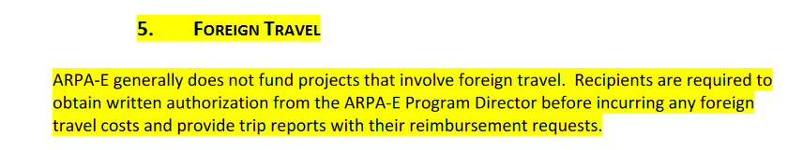
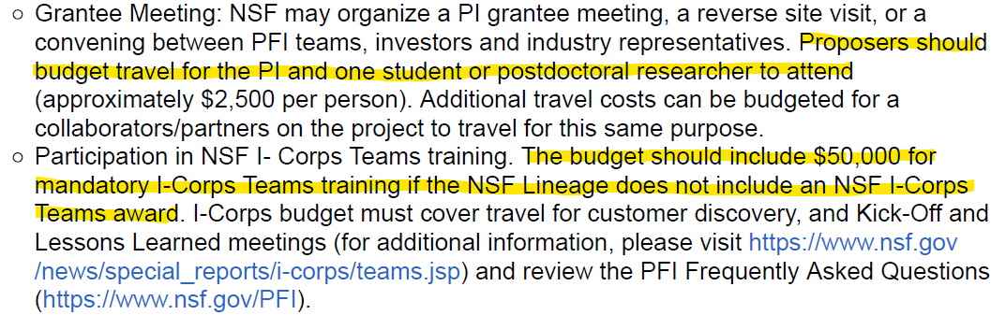
Funding Opportunity Budgeting Guidelines

Slide 9
Other Considerations
Travel
Internal User Fees
Capital Equipment & Fabrications vs non-capitalized equipment and supplies
External Collaborators: Subaward vs Vendor/Contractors
Direct vs Indirect Costs & MTDC
Notes:
As you saw in the last slide travel can fluctuate depending on the sponsor. If you are budgeting for travel without a cap itemize all anticipated expenses, look at airfare, lodging, use per diem calculators. For internal user fees ask for quotes from cores and look at historical data. Equipment is defined as having an aquation cost greater than $5,000 AND a service life of over one year otherwise it usually falls into the ‘supplies’ category. You find a bargain on a microscope for 3,5000 that’s supplies. On the other end of the spectrum when fabricating equipment (engineering) if the individual components cost less than 5,000 but when combined and assembled the total costs exceed 5,000 with a useful life spanning over 1 year, it is considered equipment. If you’re working with external collaborators, make sure you’re using the proper classification. A good rule of thumb is that subawards are for collaborators contributing to the scientific portion of the project or could be considered a co-author on a publication resulting from the award. Whereas a vendor is providing a good or service that is routine and provided to many different purchasers. Pay attention to direct v. indirect costs and calculating MTDC. MTDC excludes equipment, tuition remission, patient care costs, and the portion of each subaward IN EXCESS of $25,000. In other words, make sure you remember to include the first $25,000 of each subaward in your MTDC.

Slide 10

Budget Templates
Internal Templates
  RSP’s
  Divisional
  Departmental
Sponsor Templates
Entry of Budget in Sponsor Submission Portal
Notes:
Several different templates available for use from RSP, your school or division, and departments. Reach out and ask. If you need to enter your budget into a sponsor’s template or portal make sure it matches your approved budget.

Slide 11

Best Practices for Cross-Campus Collaboration
Communicate!
  Deadlines
  Requirements
  Budgetary Limitations
Check your rates!
Create separate budgets for each PI for smoother project setup

Slide 12
Part II:
Budget Justifications
Lori Uttech-Hanson
A budget narrative is a crucial component of grant proposal. A well-prepared budget narrative may significantly increase the chances of securing the funding amount requested. In this portion of the presentation, you will learn how to develop a detailed budget narrative that serves to explain, justify, and contextualize the financial aspects of a project; and that enhances transparency, demonstrates alignment with project goals and compliance with funder requirements, instills confidence in grantors, and supports post-award implementation and understanding.

Slide 13


Budget Justifications: What and Why?
What is a Budget Justification?
  Detailed breakdown of proposed budget in narrative form - rationale behind each expense
  A “recipe”
  Convinces reviewers that your requested budget is appropriate, reasonable, and needed (justifiable!)

Slide 14

Budget Justifications: Why?
Why is a Budget Justification Important?
  Transparency and Accountability
  Demonstrates Fiscal Responsibility
  Supports Achievement of Project Goals
  Documents Feasibility
  Clarifies Unusual or High-Cost Items
  Facilitates Decision-Making (when developing
  and spending)
  Enhances Grant Review Process
    May serve to reduce budgetary cuts!
  Competitive Advantage
  Post-Award Administrative Guidance
Notes:
Point out that the budget should directly support your states goals, activities, strategies, and/or aims. Do not include an item in the budget that does not support and activity. In some cases you may want to state in the budget narrative who goal, aim, or objective the item or costs supports (e.g., Dept of Education grants).
Can we successfully complete this project in the requested amount?
I did not put the budget together, but I am administering it – guides me in how the funding can be spent.

Slide 15

How To Prepare Effective Budget Justifications (For Pre- and Post-Award)
Follow clear organization aligned with application instructions.
  Develop a template that follows detailed budget.
Translate the budget line items into narrative.
  Collaborate with team members, post-award staff, and other stakeholders for feedback.
  Provide supporting detail to explain and justify costs for each project year.
Ensure budget justification aligns with and supports goals, aims, strategies, and activities stated in project narrative.
Write for the future (post-award).
Provide guidance (and a template) to subawards, consultants, fee for services, etc. for budget narrative.
Notes:
Add a quote (equipment) or consultant MOU/LOS that documents costs (consultants).

Slide 16
Typical Expense Categories (NIH/DOD Example)
Personnel (Salaries/Wages/Fringe)
Equipment
Participant Support/Trainee Support Costs
Travel
Other Costs
Materials & Supplies
Publication Costs
Consultant Services
Automatic Data Processing (ADP)/Computer Services
Subawards/Consortium/Contractual Costs
Equipment or Facility Rental/User Fees
Alterations and Renovations
Other (Data Management and Sharing Costs, Tuition, etc.)
Indirect Costs

Slide 17
Tips for the Narrative…
Personnel (State name, role, effort): State “what” they will be doing that will justify their effort. Explain changes by year. Link to specific tasks, aims, or strategies, if applicable (e.g., Aim 2; Objectives 3 & 4, etc.)
  Organize alphabetically (helps the reviewers)
  Fringe Benefits: Include how calculated and refer to UW policy.
Equipment: Make sure this is allowable; include a quote, bid, or letter. Itemize the details (equipment, shipping, service contract, accessories, etc.).
Travel: State how travel is related to the research, who will travel and why; include breakdown of expenses (e.g., name/location of event, # of travelers, airfare, hotel, per diem, number of days, mileage reimbursement). A table is helpful.
Notes:
Personnel: Do not need to highlight their expertise if they have a biosketch attached – this should be in the Personal Statement. If do not have a biosketch attached, you may provide detail on their expertise or specific skill set).
Travel: Be specific about what conference they will be attending and where it will be held. Do your research – look it up! (cots of airfare, registration fees, if transportation is provided from airport by hotel, etc.). State if domestic or foreign.

Slide 18
Tips for the Narrative, continued
Other Direct Costs: Organize by subcategories (e.g., materials and supplies, publications, consultant, computer services, etc.).
  Materials & Supplies: Itemize! For previously used supplies - base figures off past POs/invoices to be realistic. For new supplies – conduct needs analysis and research costs.
  Consultants: In general, include name for each Consultant and itemize each consultant, rate per day, number of days of expected service, any additional costs such as travel, lodging, supplies, and total costs for each consultant. Include a letter of support/MOU.
  Consortium Costs: Include a brief summary of costs and refer to independent budget.
  Equipment or Facility Rental/User Fees: State rate and duration of rental / Detail service, how relates to project, and breakdown of costs.
  Other: Tuition, Data Management and Sharing Costs, Etc.
Indirect Costs: Describe rate and list UW rate agreement and date.
Notes:
Beware of foreign consultants embedded in subawards! (post award implication for export control)

Slide 19

Budget Justifications and Budget Modifications
(For Pre- & Post-Award)
Reflect Modifications in Revised Budget Justifications
  Just-In-Time
  Notice of Award
  Post-Award

Slide 20

Example Budget Justifications
Review examples of detailed budget justifications.

Slide 21

Summary
A budget justification is a critical component of a grant application that provides a clear, detailed, and well-reasoned explanation for each line item in the budget. It serves to build trust with funders, align the budget with project goals, and ensure responsible use of grant funds. It is an essential tool for effective grant proposal development and review, as well as grant administration.

Slide 22
Part III: The Post Award Side
Courtney & Lori

Slide 23

Budgets Post Award
Budget Flexibility
Edits and Multiple Projects
Commitments, Cost Share, and Subaward Concerns
Read and know the NOA!
Budget Errors Can Cause Problems

Slide 24

Budget Flexibility
Do you have budget flexibility?
Uniform Guidance 200.308(f)
Research Terms & Conditions
Change in scope?
Notes:
Courtney

Slide 25

Edits and Multiple Projects
Expanded edits allow other departments to utilize the award
Using multiple projects can help with post award grant management
Use your budget as a guide
Notes:
Courtney

Slide 26
Commitments, Cost Share, and Subawards
Commitments
Can cause problems post award if your PI is successful with proposals
Cost Share
Be aware of cost share at time of proposal
Don’t let your PI volunteer cost share!
Cost share must be set up when the award comes and tracked post award
Subawards
Be aware of outgoing subawards
Department initiates subaward in the Subaward Portal
Monitor subaward invoicing as the award goes on
There’s only so much time and effort to spread around!
Notes:
Lori

Slide 27
Be Aware of Changes From Proposal to Award
Review the NOA!
  Change of Scope Needed?
  Terms & Conditions
Salary: Make sure you are ready if salary has changed from time of proposal to time of award, or during the life of the award.
Fringe Rates: Fringe rates change every fiscal year. Review how your budget looks when awarded and pay attention as fringe rates change.
Consultants/Subawards/Employees: Has anything changes? Persons still with organization? Roles?
Notes:
Lori
May need to change scope and seek prior approval
Story of interim progress report due
Budget changed from 5 to 4 years
Staff still at the organization; still in business? Etc.

Slide 28

Beware of Budget Errors
Budget errors can
wreak havoc!

Slide 29

Common Budget Errors (not exhaustive)
Exceeding FOA budget amount
Not requesting prior approval
Using an incorrect budget form
Calendar months effort does not equate to the requested salary
Miscalculation of F&A (particularly with subawards)
Costs in budget differ from justification
Made up numbers! (e.g., supplies, travel, etc.)
Letter of support or MOU is not included for consultants
Lack of detail and itemization on justifications
Including costs that are not allowable (& trying to justify them in another way)
Consultant vs Subaward
Whether subaward costs are or are not considered part of total direct costs for prime
Not explaining significant changes by year; including is subaward has omitted budget periods
Including staff/student time as an “Other Direct Cost” for their role
Notes:
Some common budget errors, so this is not an exhaustive list, but these are the ones that we see most frequently: requests that exceed the amount of budget allowed in the FOA; NIH not seeking permission to exceed $500,000 before submitting the application, using an incorrect budget form (use the sponsor’s template) The calendar months don't equate to what's in the budget request; a miscalculation of the indirect cost rates; And the grand finale this is the number-one thing. Costs in the budgets differ from the justification.

Slide 30
Resources
Uniform Guidance: https://www.ecfr.gov/current/title-2/subtitle-A/chapter-II/part-200/subpart-E
RSP’s Budget Development Tools: https://rsp.wisc.edu/forms/budgettools.cfm
Allowable Direct Costs: https://rsp.wisc.edu/awardmgt/directcosts.cfm
Subaward vs. Vendor vs. Consultant: https://rsp.wisc.edu/awardmgt/outgoing_subs/
Guidance for Contracting External Services: https://rsp.wisc.edu/SAGuidance/
Capital Equipment: https://businessservices.wisc.edu/accounting/capital-equipment/
NIH Budget Building Blocks: https://www.youtube.com/watch?v=minIpd4DncI&t=690s
NSF Preparing Your Budget: https://new.nsf.gov/funding/proposal-budget

